Slide 1
The Digital Abstraction

Slide 2
Index
Managing Complexity
Abstraction
Discipline
The Three -Y’s
Digitalization
Sampling
Quantization
Sensors
Amount of information
Boole Algebra

Slide 3
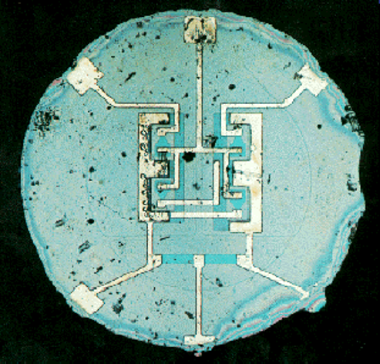
Complexity (1)
Microprocessors revolutionized our world during the past three decades
an electronic circuit that acts as the brain of a computer. It performs arithmetic, logic, control, and input/output (I/O) operations by following instructions in a program.
laptop computers today have far more capability than a room-sized mainframe of yesteryear
automobiles contain about 100 microprocessors
worldwide semiconductor industry sales have grown from US $21 billion in 1985 to $520 billion in 2023
Digital systems are being built from millions or billions of transistors
a tiny electronic component that can act as a switch (or an amplifier). It controls the flow of electrical current in a circuit and is the building block of electronics
no human could understand these systems by writing equations describing the movement of electrons in each transistor and solving all of the equations simultaneously
we need to learn to manage complexity to understand how to build a digital system (like a microprocessor) without getting lost in a morass of detail

Slide 4
Complexity (2)
Microprocessors revolutionized our world during the past three decades
an electronic circuit that acts as the brain of a computer. It performs arithmetic, logic, control, and input/output (I/O) operations by following instructions in a program.
laptop computers today have far more capability than a room-sized mainframe of yesteryear
automobiles contain about 100 microprocessors
worldwide semiconductor industry sales have grown from US $21 billion in 1985 to $520 billion in 2023
Digital systems are being built from millions or billions of transistors
a tiny electronic component that can act as a switch (or an amplifier). It controls the flow of electrical current in a circuit and is the building block of electronics
no human could understand these systems by writing equations describing the movement of electrons in each transistor and solving all of the equations simultaneously
we need to learn to manage complexity to understand how to build a digital system (like a microprocessor) without getting lost in a morass of detail

Slide 5
Abstraction
Hiding details when they are not important!
lowest level is physics: motion of electrons (quantum mechanics and Maxwell’s equations)
electron devices (transistors) have well-defined connection points (terminals), we can ignore the individual electrons
devices are assembled to create analog circuits (amplifiers) that input and output continuous voltages
digital circuits (logic gates) restrict the voltages to discrete ranges (indicate 0 and 1)
from digital circuits we build more complex components (adders or memories)
the micro-architecture level describes the system from data and operations perspective
the architecture level describes the system from the programmer’s perspective
…ad so on: operating system (handles hard drive or managing memory) and finally, application software…

Slide 6

Discipline
Intentionally restricting the design choices so that one can work more productively at a higher level of abstraction
Famous example (1908): Ford Model T
previous cars were hand-crafted by skilled men
time-consuming and expensive process
Henry Ford focused on mass production with interchangeable parts and moving assembly lines
by limiting components to a standardized set with well-defined tolerances, cars could be assembled much faster and with less skill
car builders no longer concerned with lower levels of abstraction (such as, fitting a door to a non-standardized opening)
Ford’s famous saying: “Any customer can have a car painted any color that he wants so long as it is black”

Slide 7
The three «-y»
Hierarchy: dividing a system into modules, then further subdividing each of these modules until the pieces are easy to understand
Modularity : modules should have well-defined functions and interfaces, so that they connect easily without unanticipated side effects
Regularity: seek uniformity among modules, common modules are reused many times, reducing the number of distinct modules that must be designed
Ford Model T example:
we can break the car into components: chassis, engine, and seats; the engine contains cylinders, carburetor, and cooling system; the carburetor contains fuel and air intakes, a throttle and so forth…the complex system is recursively broken down into simple interchangeable components (hierarchy)
the coupling nut has a function of holding the fuel feed line to the intake elbow and it is of a standardized diameter and thread pitch, tightened to a standardized torque by a standardized wrench (modularity)
a car maker can buy the nut from many different suppliers, if the correct size is specified (regularity)

Slide 8
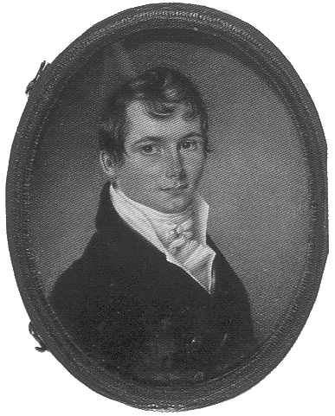
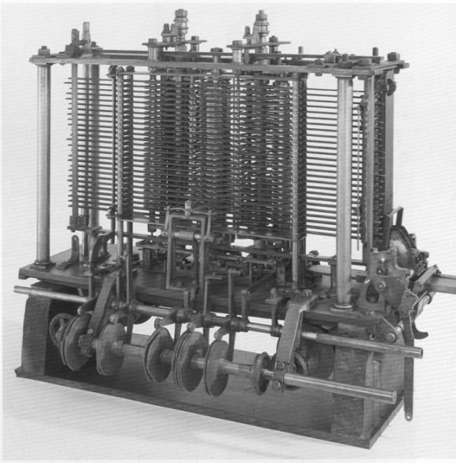
The Digital Abstraction
Digital circuits use discrete voltages, analog circuits use continuous voltages
a subset of analog circuits
much simpler to design
By limiting ourselves to digital circuits, we can easily combine components into sophisticated systems that ultimately outperform those built from analog components in many applications
digital -televisions, -cameras and -phones replace their analog predecessors
Digital systems represent information with discrete-valued variables
An early digital system:
Charles Babbage’s Analytical Engine (1834-1871)
use 25 gears with ten positions labelled 0 through 9
Electronic digital system use a binary representation (two-valued) in which a high voltage indicates a “1” and a low voltage indicates a “0” : bit ("binary digit”)
why only two? It is easier to distinguish between two voltages than ten…

Slide 9
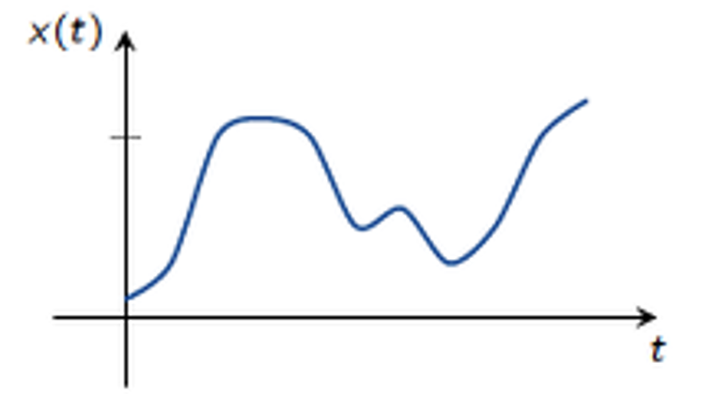
Digitalization (1)
The numeric representation x of a physical phenomenon over time is continuous x(t)
at least at non-quantum scale
e.g. temperature of a room, intensity of a light, force applied to an object, etc.
The analog representation seems the most suitable and effective
Our abstraction needs a device able to convert continuous quantities variables into digital ones
Analog to Digital Converters (ADC)
We need to digitize the signal both in time and in amplitude
sampling and quantization

Slide 10
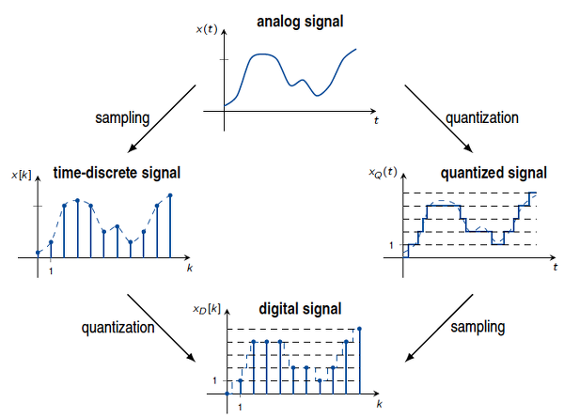
Digitalization (2)

Slide 11
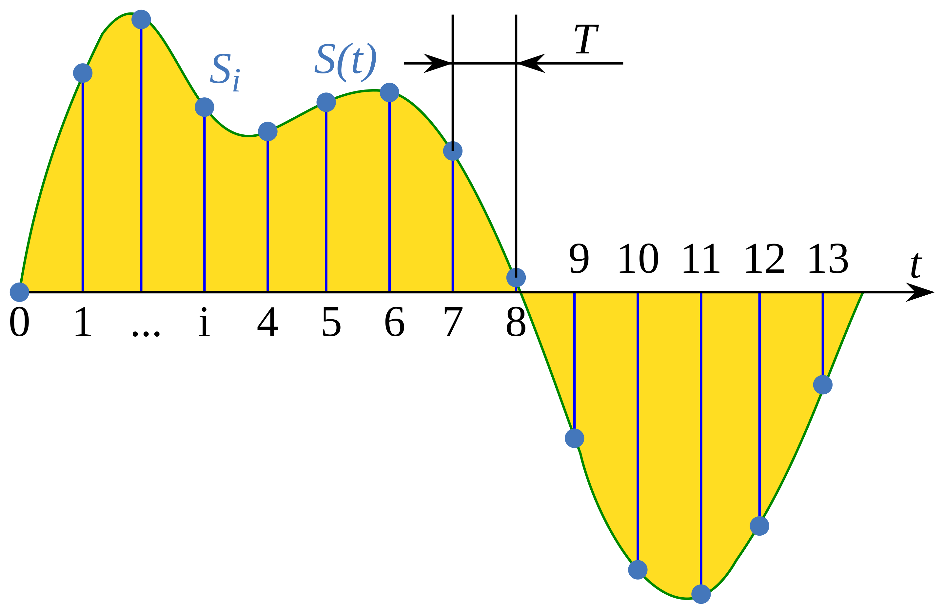
Sampling
The reduction of a continuous-time signal to a discrete-time signal
sample: a value of the signal at a point in time
by measuring the value of the continuous function every T seconds
sampling period T
sampling frequency f_{s} = 1/T (sample per second, hertz)
Which period T we need to use?

Slide 12
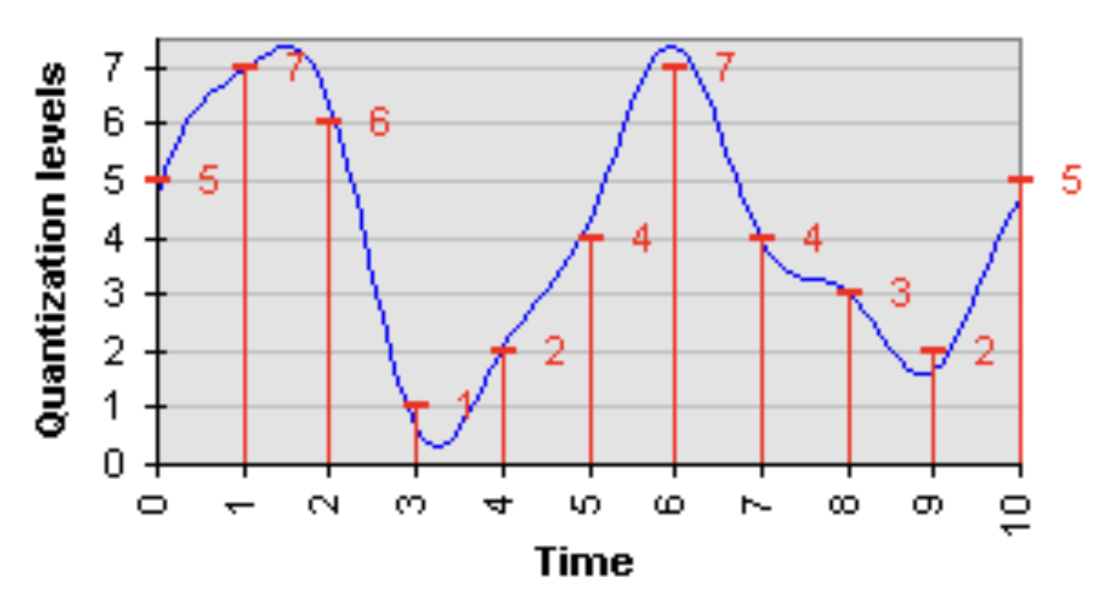
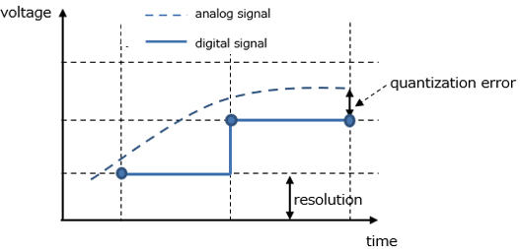
Quantization
Mapping input values from a continuous set to output values in a finite number of elements
rounding and truncation are typical examples
Quantization error
difference between the input value and its quantized value
Resolution
minute change in the input analog signal which changes the output digital signal

Slide 13
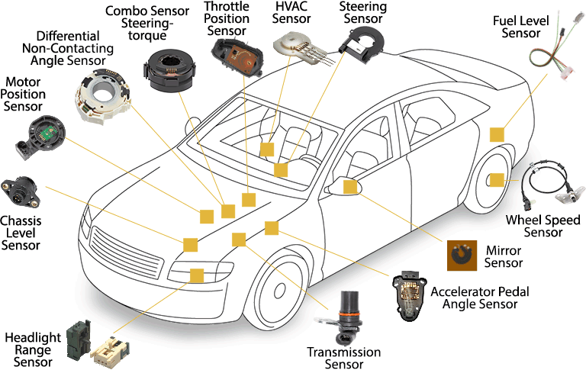
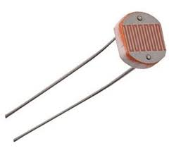
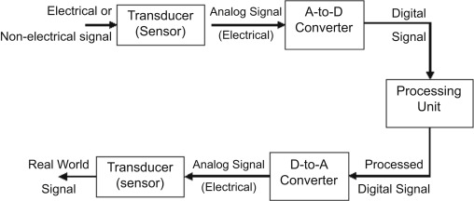
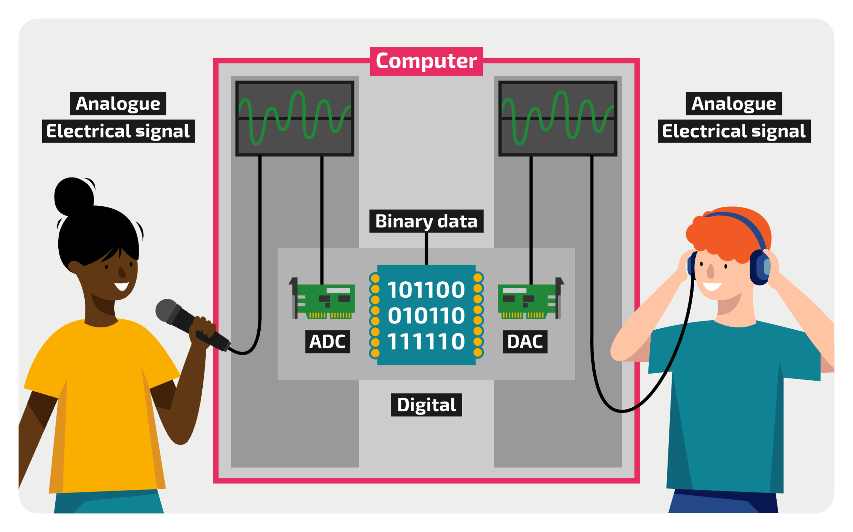
Sensors
A device that produces an output signal for the purpose of sensing a physical phenomenon (like heat, pressure, humidity, movement, etc.)
Example, light sensor: light sensitive resistors whose resistance decreases as the intensity of light they are exposed increases
ESD

Slide 14
The amount of information
A set of S symbols and a word of length D, we can obtain S^{D} distinct encodings
If we have a set of N objects that we want to encode, then S^{D} >= N
In general, we know N and S and we want to find the minimum D >= log_{S} N
The amount of information D of discrete variable (S=2) with N distinct states is measured in units of bits as:
D = log₂N [bits]
Examples:
a binary variable has log₂2 = 1 bit of information
to represent the 75 alphanumeric values (uppercase and lowercase characters, digits and special characters) we need a variable with 7 bits
original ASCII (American Standard for Information Interchange) code was 7 bits
a continuous signal theoretically contains an infinite amount of information because it can take on an infinite number of values
in practice, noise and measurement error limit the information to only 10 to 16 bits for most continuous signals

Slide 15
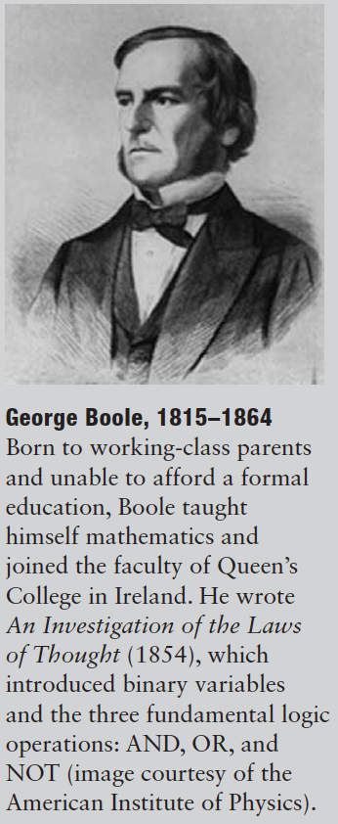
Boole Algebra
Digital signals may be treated with discrete math
If we limit to the case of only two values (the binary case), we can refer to the boolean algebra
The beauty of the digital abstraction is that digital designers can focus on 1 and 0, ignoring whether the boolean variables are physically represented with voltages, rotating gears, or even hydraulic fluid levels
a computer programmer can work without needing to know the intimate details of the computer hardware
on the other hand, understanding the details of the hardware allows the programmer to optimize the software better for that specific computer

Slide 16
Exercises
Ex1.1: An analog voltage is in the range of 0–5V. If it can be measured with an accuracy of ±50 mV, at most how many bits of information does it convey?
Solution: an accuracy of +/- 50mV indicates that the signal can be resolved to 100mV intervals. There are 50 such intervals in the range of 0-5V, so the signal represents log₂50 = 5.64 bits of information
Ex1.2: A classroom has an old clock on the wall whose minute hand broke off. (a) If you can read the hour hand to the nearest 15 minutes, how many bits of information does the clock convey about the time? (b) If you know whether it is before or after noon, how many additional bits of information do you know about the time?
Solution: (a) the hour hand can be resolved to 12 * 4 = 48 positions, which represents log₂48 = 5.58 bits of information. (b) Knowing whether it is before or after noon adds one more bit

